Slide 1
Group meeting 4
2021.3.16 VE490 Kexin Li

Slide 2
Progress
Experiment
Bought: microscope, 0.5 m polystyrene latex spheres, 550g PDMS.
Two masks for electrodes and channels respectivitly have been recieved.
Theory
No progress.
Simulation (currently)
2D: the electrodes failed to act on the fluid…
3D: not convergent -> no solution…

Slide 3
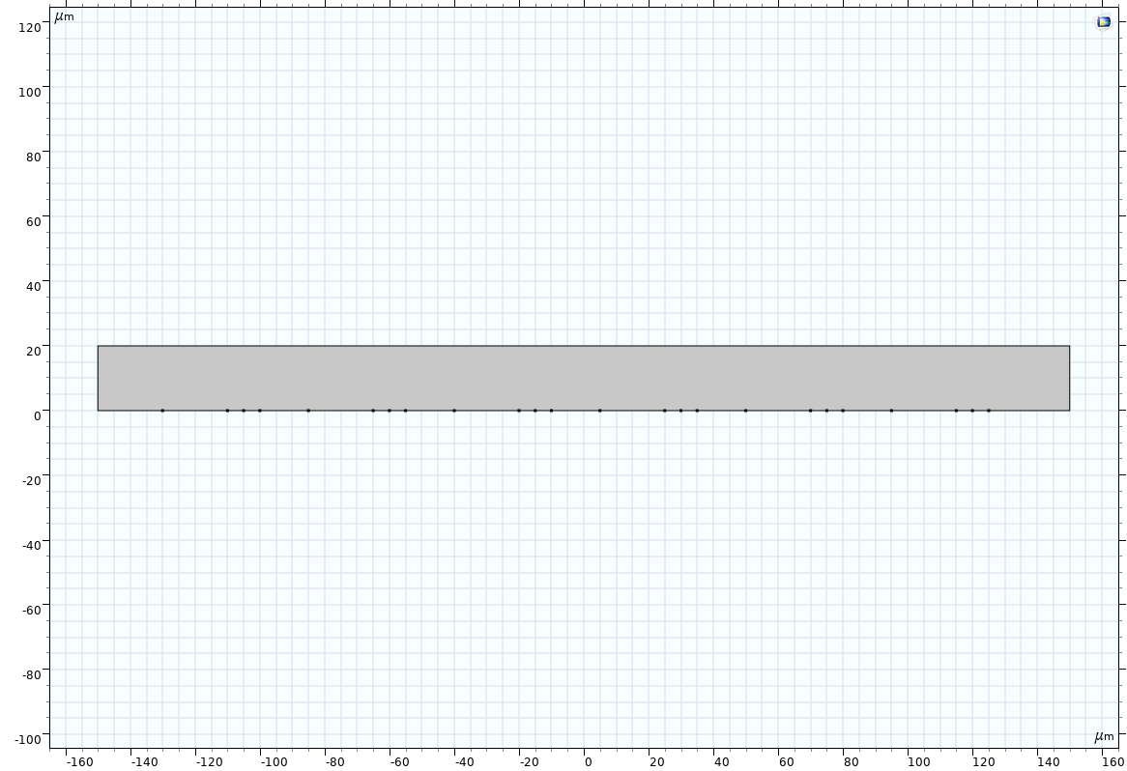
2D geometry
L=20μm
S=5μm
G1=5μm
G=15μm
6 pairs
40μm
Gap(G)
Gap(G1)
outlet
inlet
Small electrode
Large electrode
y
x

Slide 4
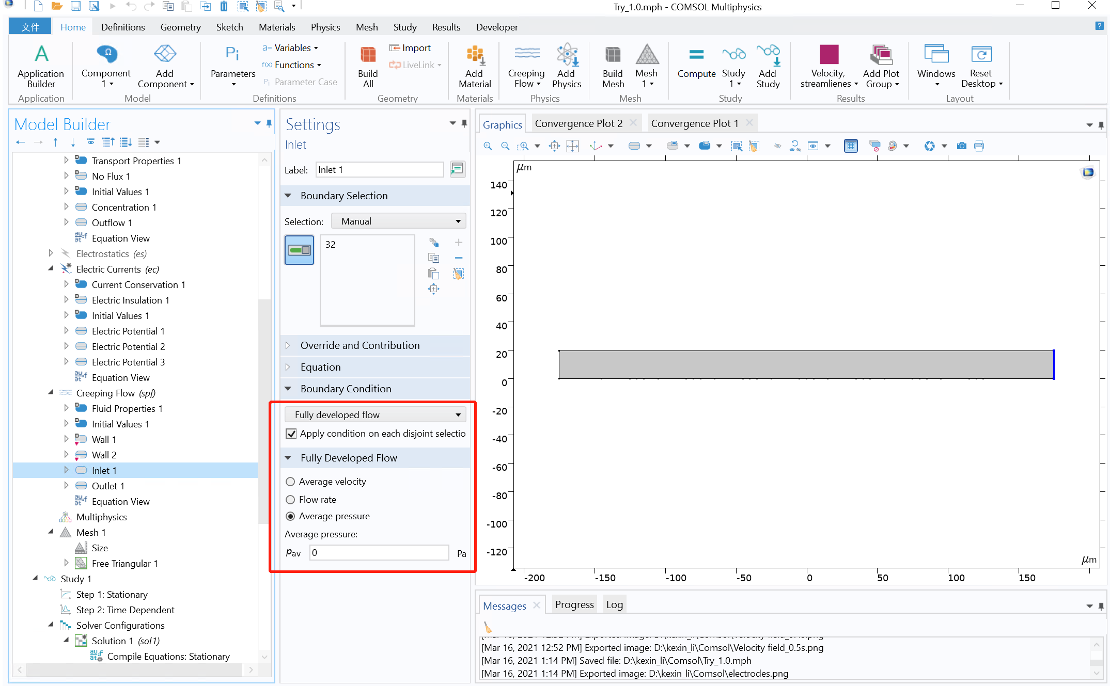

Slide 5


Slide 6
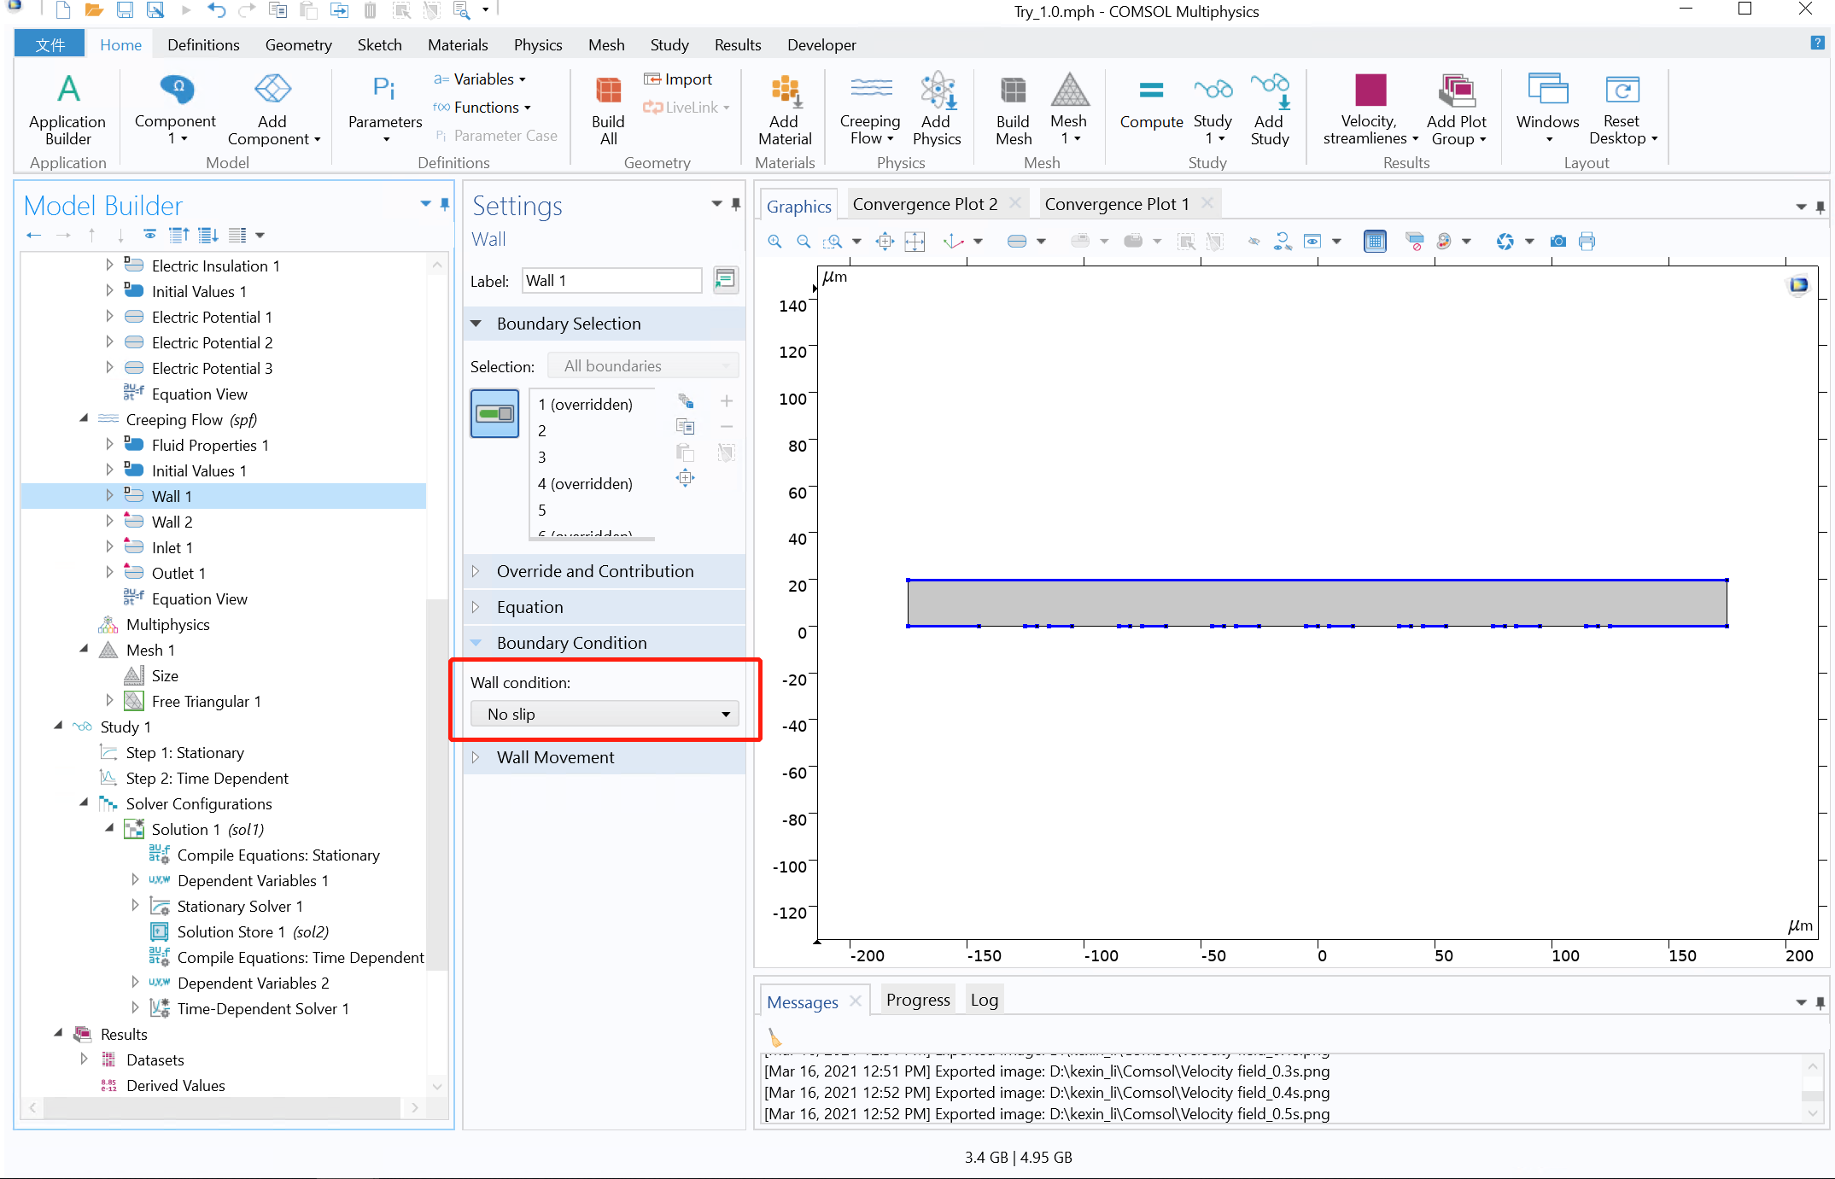
Notes:
Wall condition of creeping flow: no slip

Slide 7
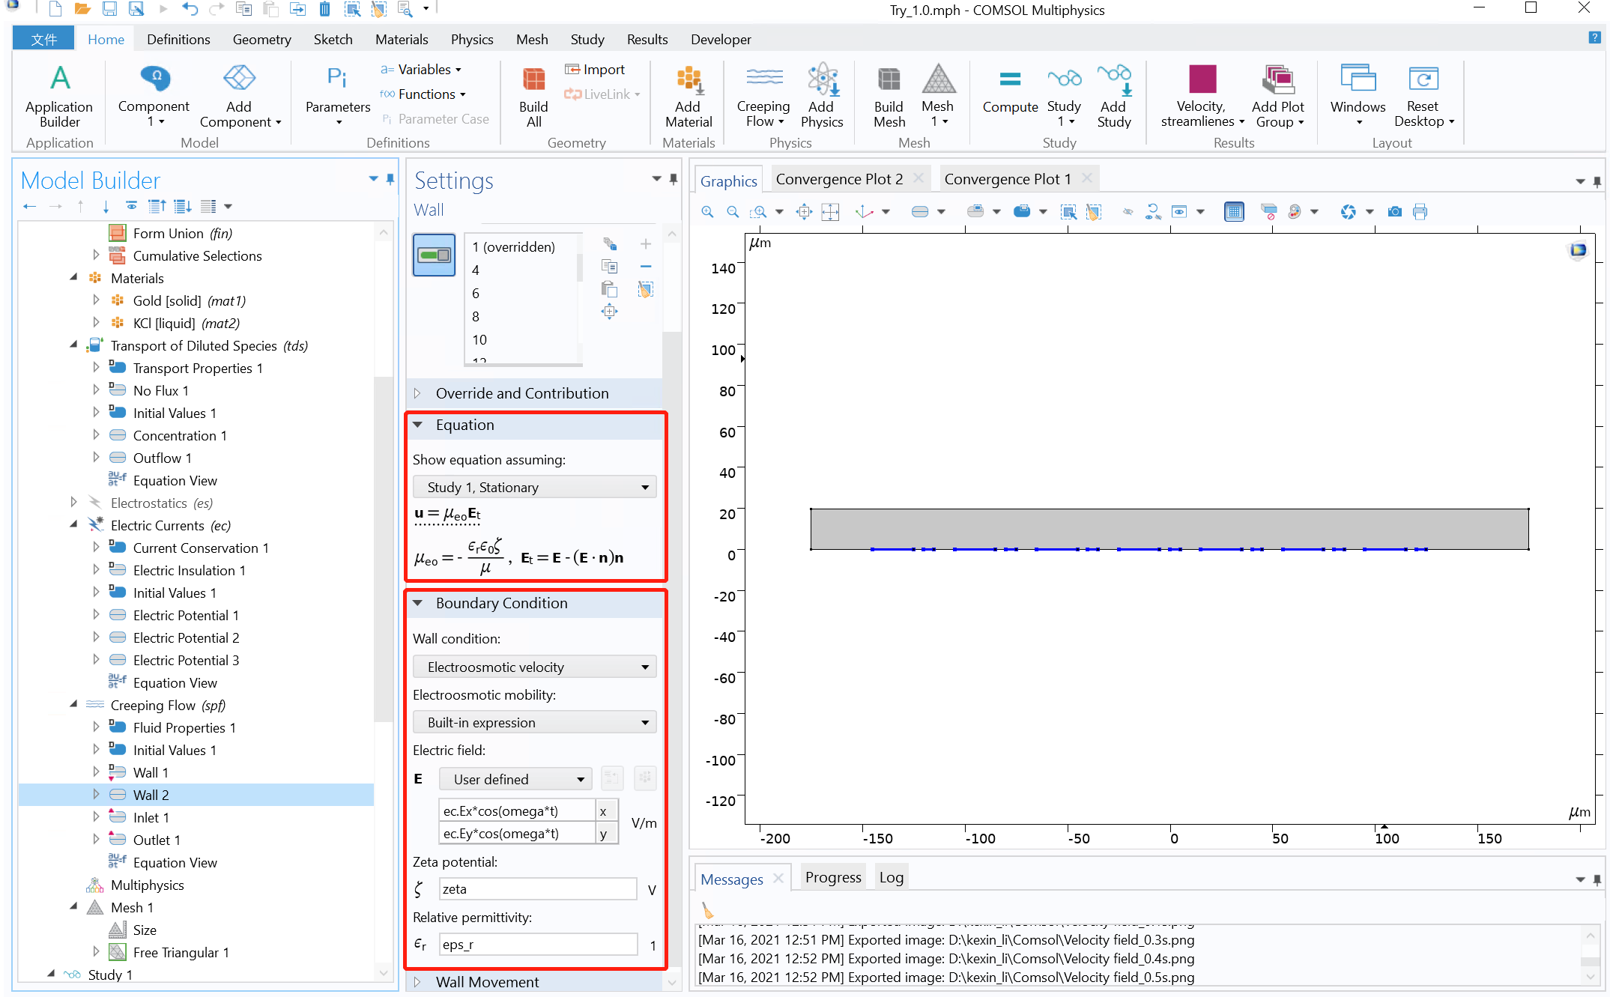
Notes:
Wall condition of creeping flow: electroosmotic

Slide 8
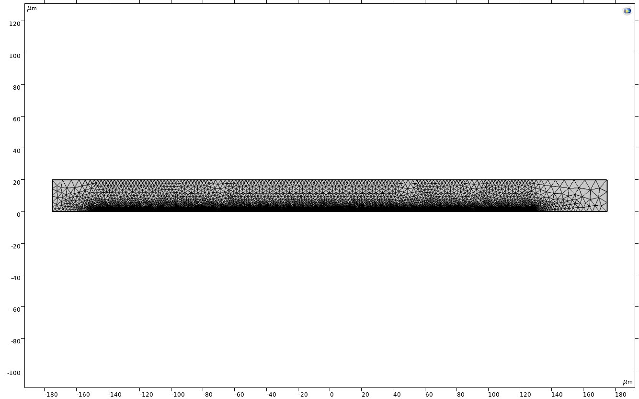
2D free triangle mesh (automatic generation)

Slide 9
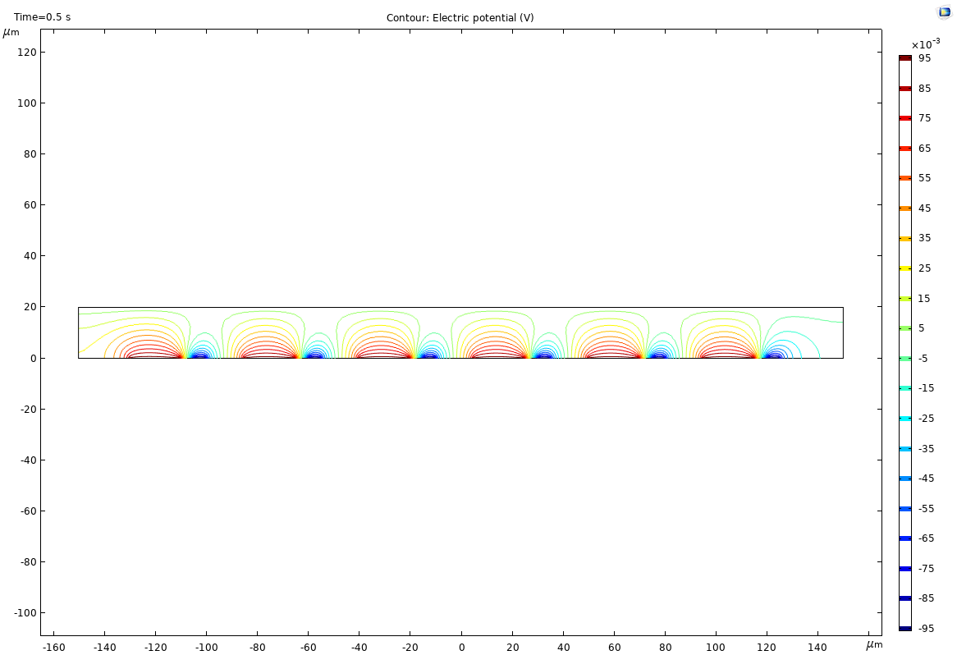
2D potential counter map

Slide 10
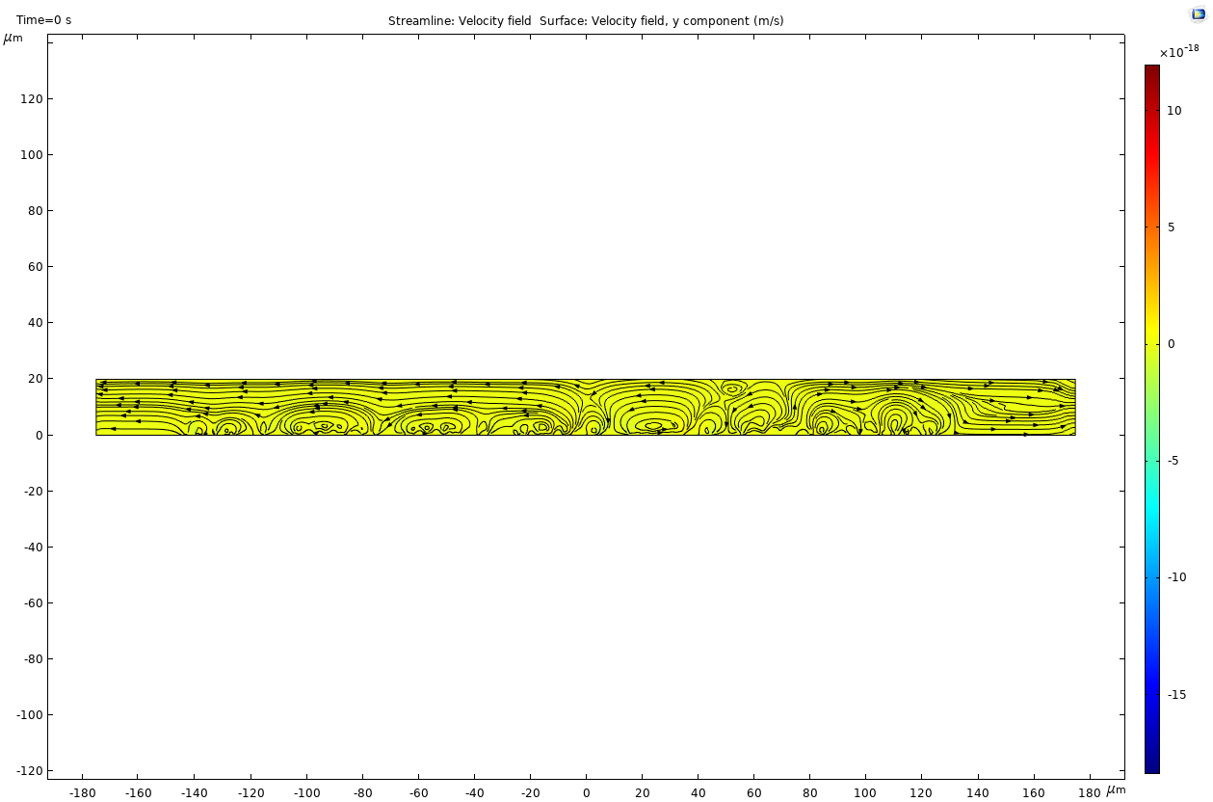
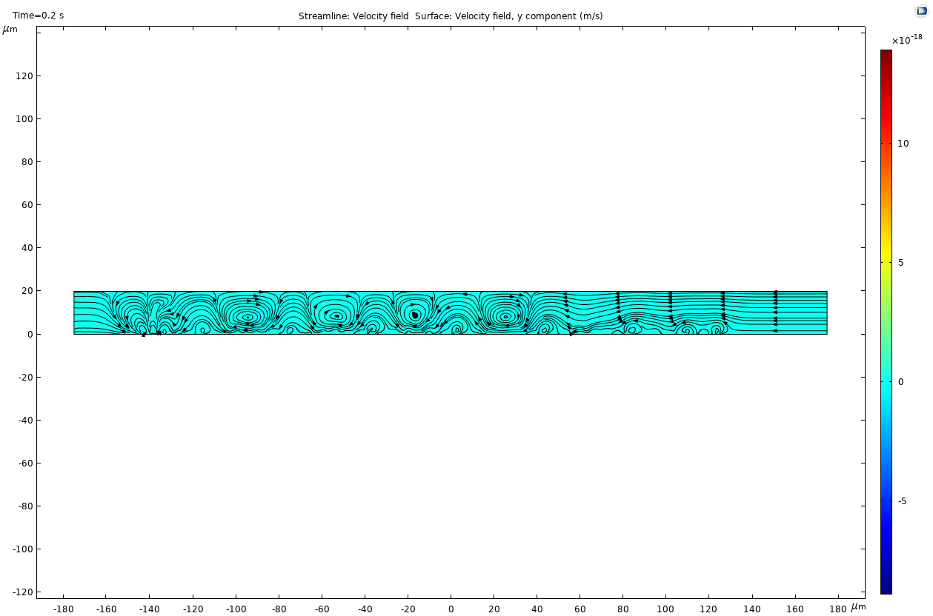
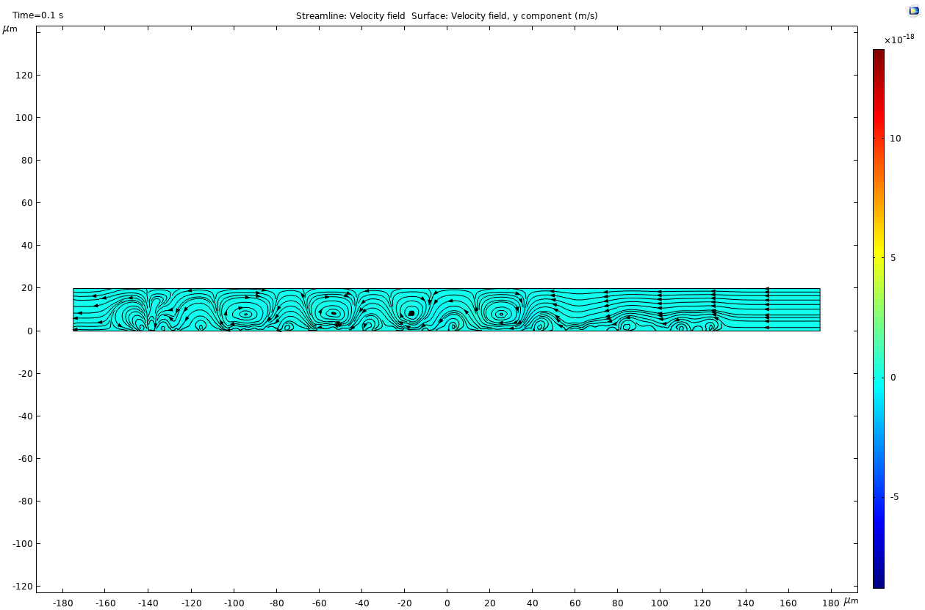
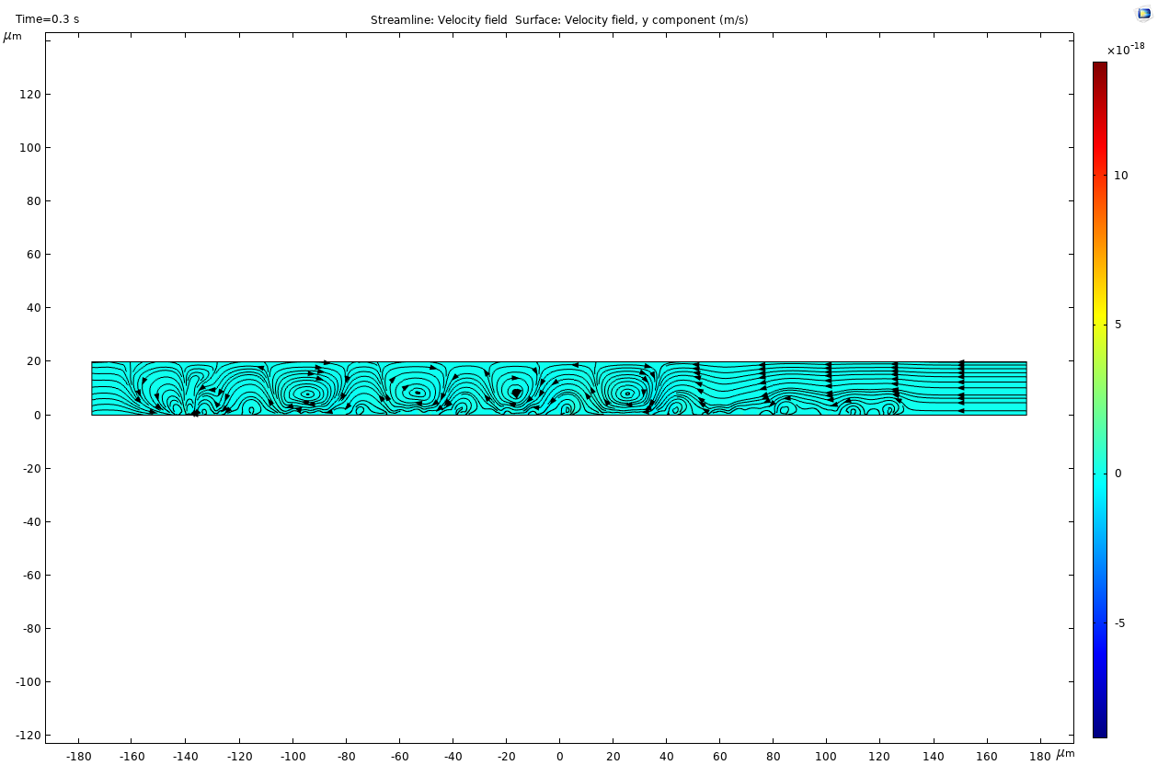
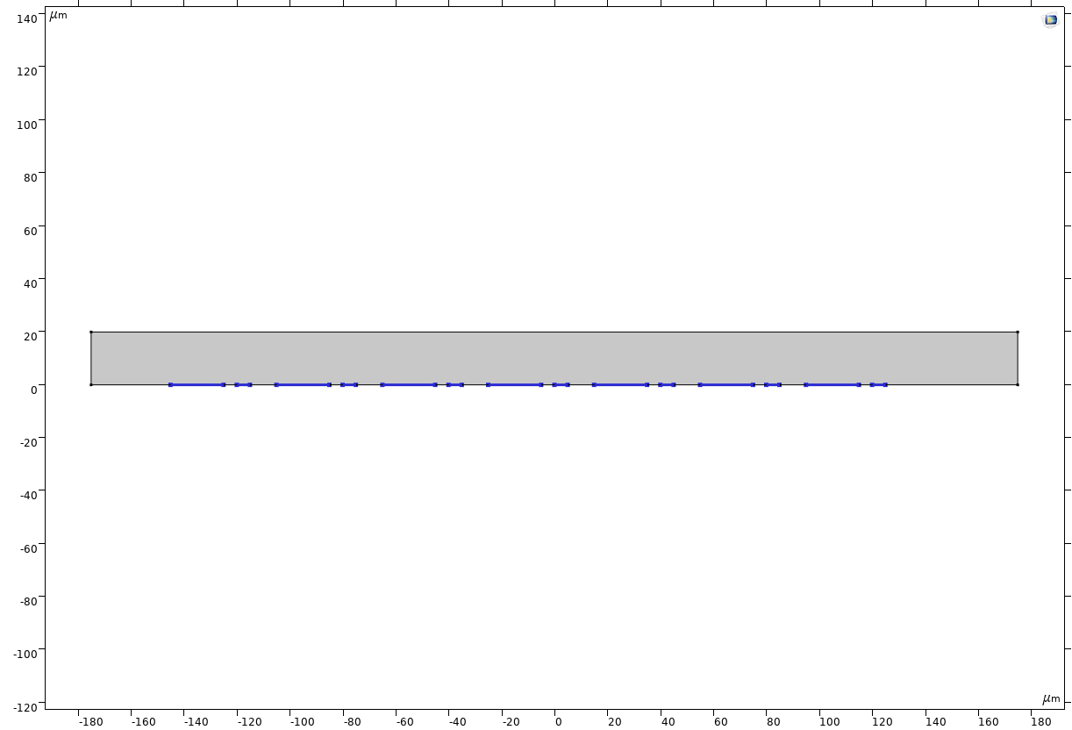
V0=±0.1V
f = 100Hz
Inlet velocity = 0
From the bar beside the graphics, the flow rate seems to be zero.
0s
0.2s
0.1s
0.3s

Slide 11


The flow stops
0.4s
0.5s

Slide 12
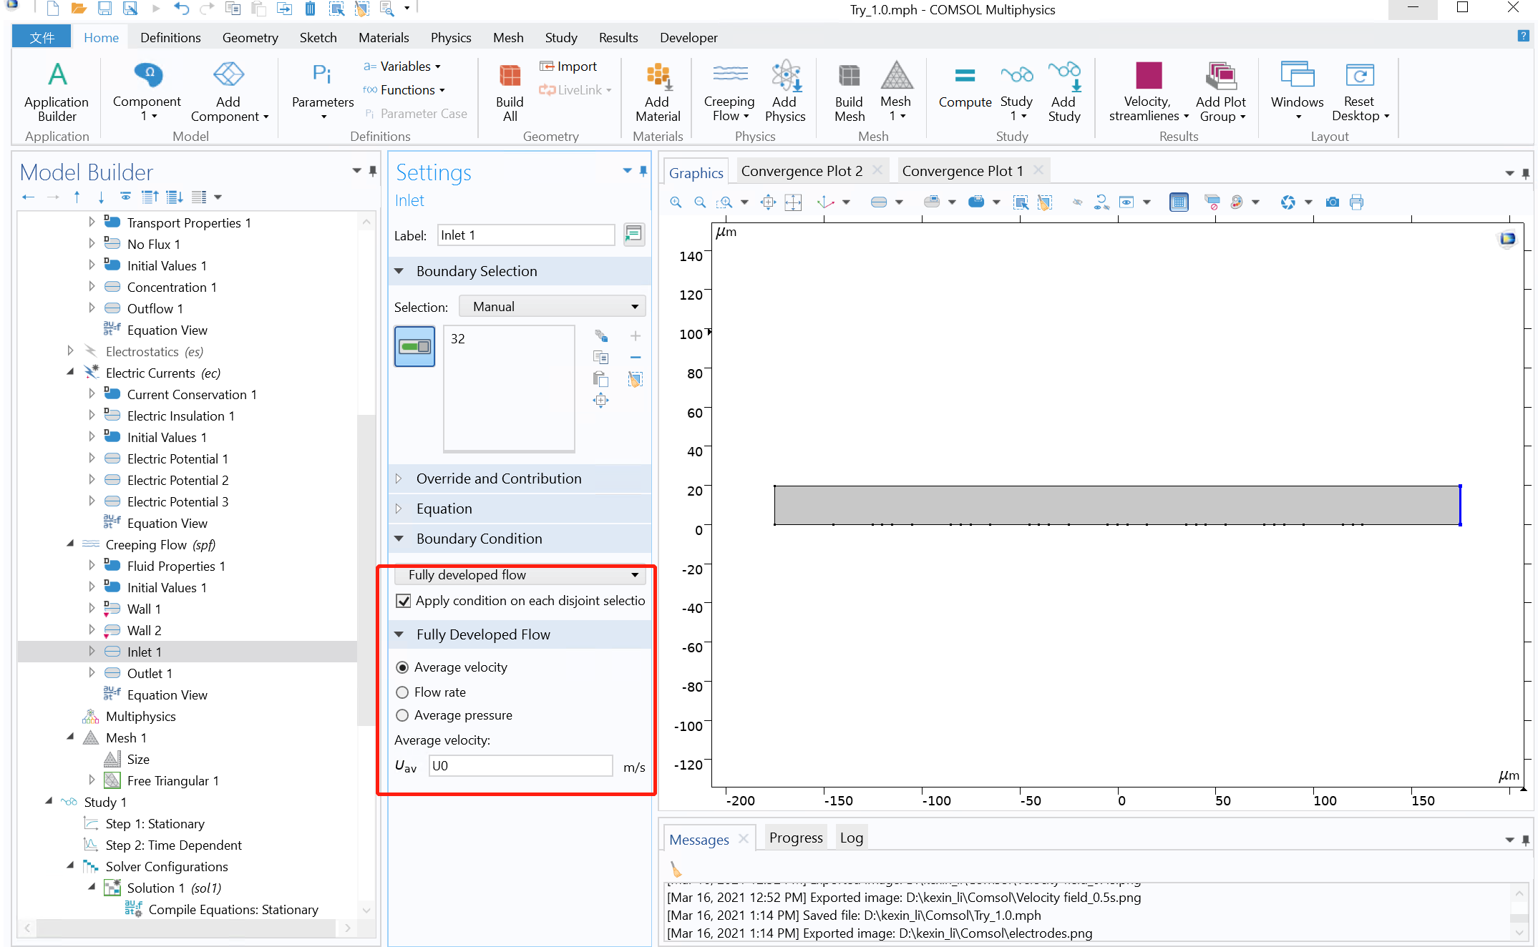
U0 = 0.01[μm/s]

Slide 13
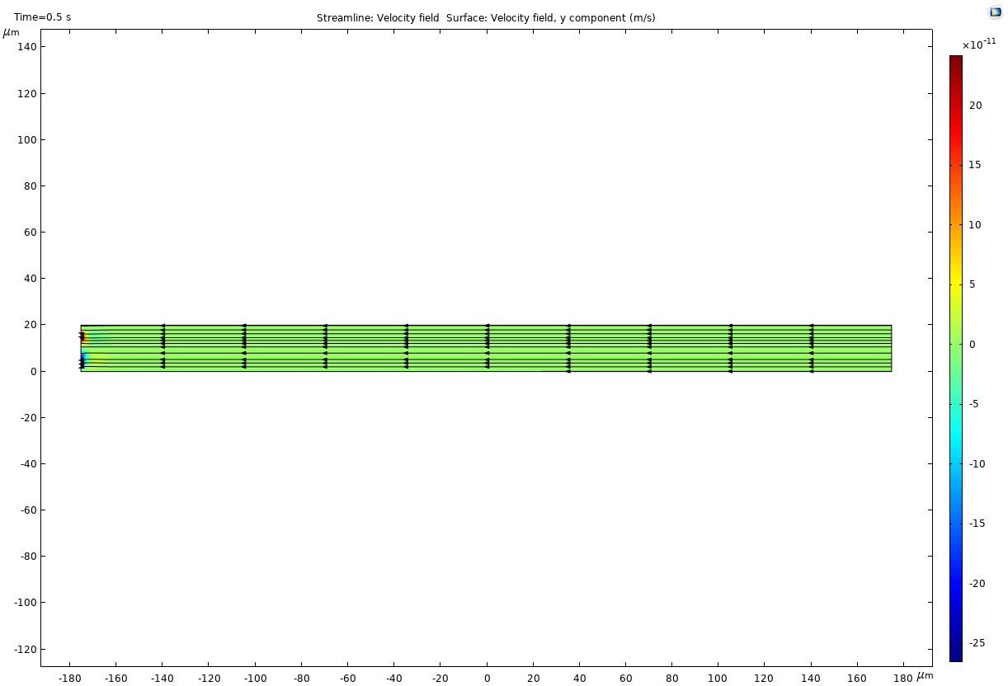
Although the velocity at the inlet is much smaller than the expected velocity generated by electroosmosis, cannot see any electroosmotic flow!
It means that the electrodes don’t generate real flow rate, which is problematic.

Slide 14
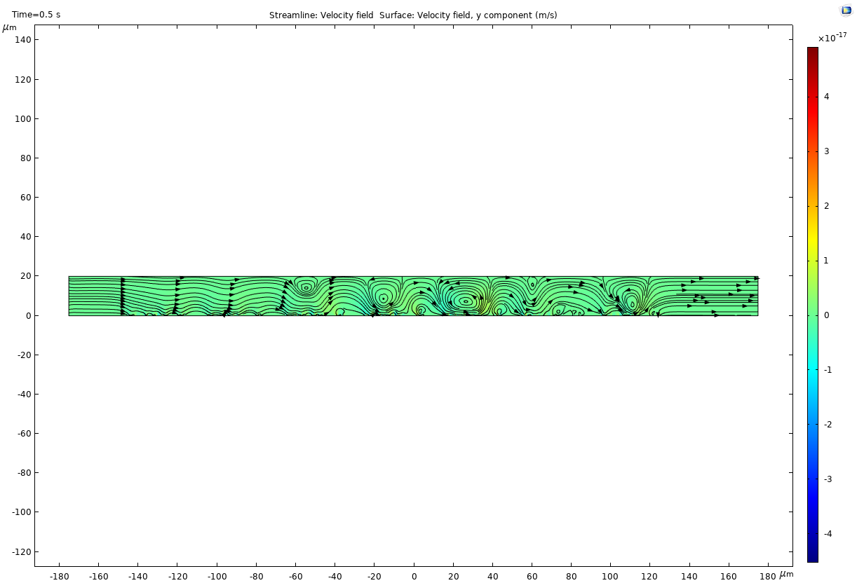
V0 = 1 [V]
The flow velocity turns direction, which is contrary to our expectation.
Problematic!!

Slide 15
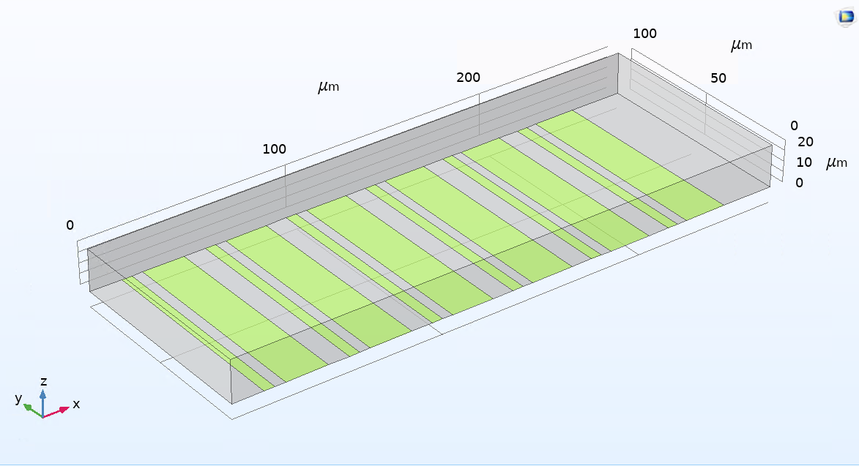
3D geometry

